Slide 1

Ready, Set, Go for PSO:
Take a Dive into PSO 2025
April 2025
Charlotte Alverson, UO
ODE-PSO Project in collaboration with
Shava Feinstein, ODE

Slide 2

Purpose:
To provide an overview of PSO processes, timeline, and resources for 2025.

Slide 3
Our assumptions:
  You are familiar with the general PSO data collection purpose and process
  You have collected and reported PSO data for multiple years
  You know how to access the PSO App in Central Login
Notes:
We assume …
If these assumptions are not true, please review other resources on the website for step by step directions.

Slide 4
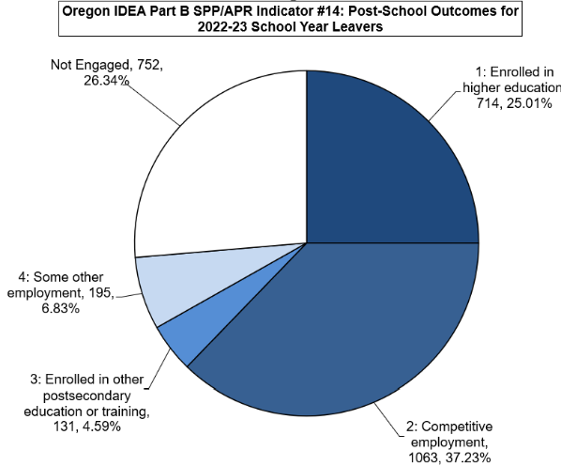
Oregon’s PSO Results for School Year 22-23
Total Former Student Leavers
  5,007
Total Respondents
  2,855 (57.02%)
Total Engaged
  2,103 (73.66%)
Not Engaged
  752 (26.34%)
Notes:
Year Total Leavers Total Respondents Total Engaged Not Engaged
FFY20 4847 2775 2001 (72%) 774
FFY21 4601 2782 2100 (75.5%) 682
FFY22 5435 2866 2135 (74.5%) 734
FFY23 5007 2855 2103 (73.66%) 752

Slide 5

Notes:
Your efforts collecting PSO data are appreciated.

Slide 6
Process Reminders:
Agency contact information must be entered for your PSO Team to proceed in PSO App.
  Administrator, Point(s) of Contact for the Exit and Follow-Up Interviews, and staff collecting or entering data in the App
  Information used to send notices and contact if a problem arises with the collection
Student List is available for review in mid-April.
  Use the Student List to verify students who are eligible for PSO data collection this year
  To make additions/deletions to the list, send only the SSID number to the ODE Data Team: ode.oss-datateam@ode.state.or.us
Highly encouraged use of the online PSO App to record attempts and interview data.
  Eliminates duplication of work effort
  Reduces likelihood of error from data entry
  Ensures right questions are asked through built in skip logic
  Includes built-in help features

Slide 7
Interview Reminders:
The interview is meant to be a conversation
Ask the question and have a conversation with the former student/designee
Listen to their answer rather than reading the answer categories
Sometimes it may be necessary to re-word a question or ask additional questions (probe) in order for former student or designee to understand the question

Slide 8
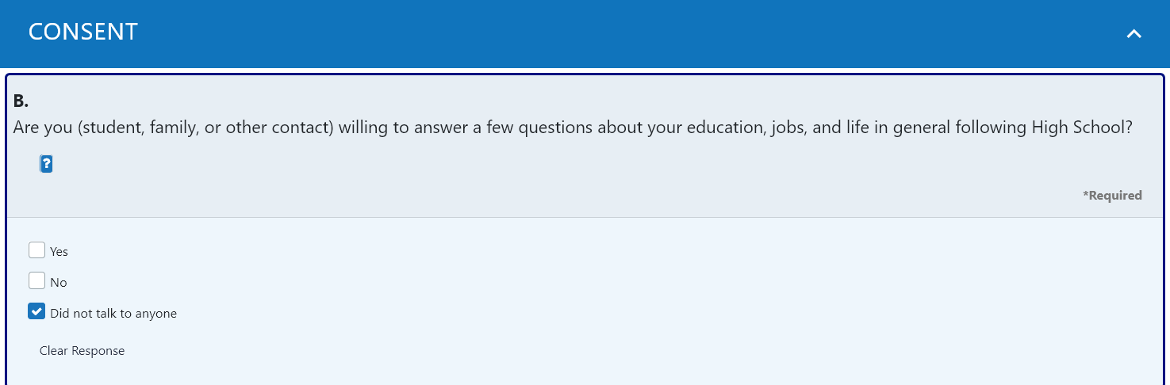

What’s New for 2025:
Response Category
Consent is not new.
New: Added a response category “Did not talk to anyone.”

Slide 9
Response Category Option
The consent question is directed to the former student or their designee
The person is answering, either:
  “Yes, I’m willing to answer questions.” (consent – agree to participate)
  “No, I’m not willing to answer questions.” (refusal – do not agree to participate)
Consent or refusal can only be obtained by talking to a person.
If you did not talk to a person, select “Did not talk to anyone.”
Notes:
Any outcome, other than talking to a person, is not a refusal:
Left message, voice mail, text – not a refusal
Phone just rang, no one answered, could not leave a message, wrong number, No contact information - not a refusal
Parent would not give phone number; doesn’t know where former student is – not a refusal;

Slide 10
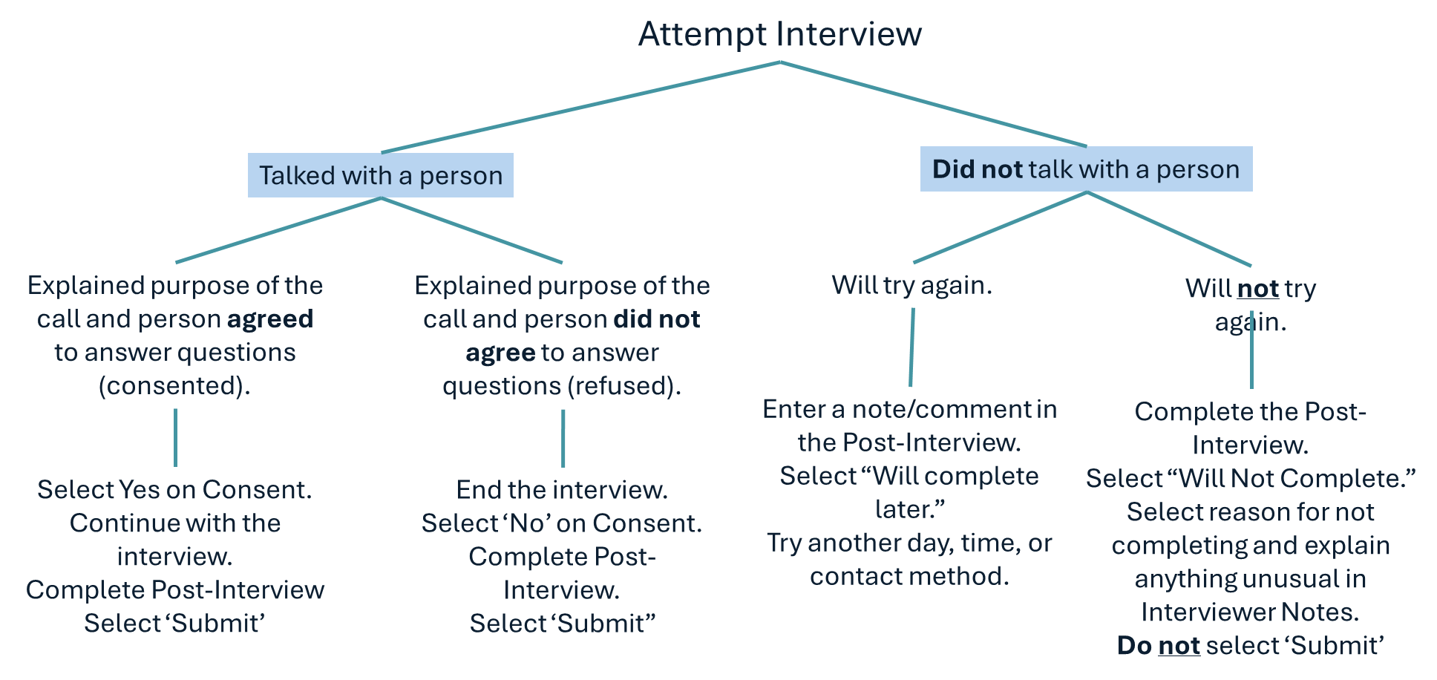
Recording a Contact

Slide 11
Recording a Contact

Slide 12
Recording a Contact

Slide 13
New Consent Response Option
Must talk to a person to record consent or refusal.
Select “Did not talk to anyone.” if you could reach a person

Slide 14
Important 2025 Dates
April 17: Student List Review Available
June 5: PSO App Opens for Data Collection
Sept 29: PSO App Closes for Data Collection
Throughout: Preliminary Results Available with in the App
Winter 2026: Final PSO Results Available

Slide 15

Resources
Visit https://transitionoregon.org

Slide 16

Contact Us
Shava Feinstein, Owner for the Collection
Shava.Feinstein@ode.oregon.gov
General PSO Questions
PSO@uoregon.edu
Charlotte Alverson
calverso@uoregon.edu
Cindy Post
Cpost3@uoregon.edu
ODE Data Team
ODE.OSS-DataTeam@ode.state.or.us

