Slide 1

Step-by-Step Guide for the Exit Interview and Input into the PSO App
The EXIT INTERVIEW
rev. April 2025

Slide 2
OBJECTIVES
PSO 2.0 Application Step by Step Guide
WHY IS THE PSO EXIT INTERVIEW IMPORTANT?
WHEN CAN THE INTERVIEW TAKE PLACE?
WHO PARTICIPATES?
WHAT IS THE PROCESS?
2
Notes:
PSO Application training – the major functions of the PSO application, how to navigate, how to enter data, etc.

Slide 3

WHY COMPLETE AN EXIT INTERVIEW?
Crucial for obtaining contact information for the Follow-Up Interview
Opportunity to engage student and family in the PSO process
Data shows that completion of Exit Interviews increases response rates for the required Follow-Up Interview
Allows time to connect with student to explain the upcoming Follow-Up Interview
Gives time to ask the student if there is a preferred person on staff they would like the Follow-Up interview with
Encourages a discussion about their future plans and allows time to share resources for their future use
3

Slide 4
WHEN DOES THE EXIT INTERVIEW TAKE PLACE?
The PSO App 2.0 is open year-round for input into the Exit Interview (some down time may occur for maintenance)
IDEAS:
Utilize the time when you process the student’s IEP meeting to conduct the interview
Provide a pizza party and enlist staff to assist with the interviews
Make the time as a one-on-one check-in with the student to chat about future plans and see if they need any assistance
Make a “reservation” with the student to complete the interview during a down time during the school day
4

Slide 5

WHO IS ELIGIBLE FOR AN EXIT INTERVIEW?
students ages 16-21 leaving with a regular, modified, or extended diploma, an alternative certificate,
reaching maximum age,
and students who dropout
Agreement To Participate is necessary from Parents/Guardians or Student if they are 18+
For the Exit Interview
5
Notes:
Signed agreement to participate is required to interview students still in school.
Documents can be found on the website, traqnsitionoregon.org under PSO Resources.

Slide 6
EXIT INTERVIEW PROCESS
BEFORE THE INTERVIEW:
Obtain an Agreement to Participate for the Exit Interview
Review student file information for demographic and contact information
Get access to the PSO 2.0 App, become familiar with PSO application
Enter demographic and contact information at any time before the interview
Set up an interview time - best would be within one month of student exit
DURING AND AFTER THE INTERVIEW:
Complete the interview electronically while using the PSO App, if possible
Have student complete the address portion of the PSO Postcard in person
Collect useful contact information for Follow-Up Interview, add electronically into Exit Interview in PSO App
Explain the upcoming Follow-Up Interview and answer any questions – Give PSO Interview Guide for Student and Family as a resource – REMINDER – a student CANNOT express yes/no for the Follow-Up Interview at this time, that will happen by contacting in one year’s time.
Update the interview if new information emerges (contact info, new goals, etc.)
Confirm ALL interviews completed with no need for further edits by clicking Mark Collection Complete
6
Notes:
Application, PSO Postcard, Interview Guide for Student and Family, other PSO documents are all found on the transitionoregon.org website under PSO Resources tab

Slide 7

Agreement to Participate
Remember, the Exit Interview REQUIRES an Agreement to Participate because the student is still in school.
Agreement to Participate:
Parent/Guardian Permission for Students ages 17 and younger to
Participate in Oregon’s Post-School Outcomes Exit Interview
Dear Parent/Guardian
A year after your student leaves high school, someone from the school district would like to call them, or you, to learn what they have been doing since leaving high school. They will ask about your student’s work and school experiences in a Follow-Up Interview. This data collection is done by all states and is known as the post-school outcomes collection, or PSO. To be able to contact your student, we would like to conduct an Exit Interview with them before they leave school. The purpose of this letter is to tell you about the PSO collection and request permission to conduct an Exit Interview with your student before they leave school.
Agreement to Participate:
Permission for Students ages 18 and older to Participate in
Oregon’s Post-School Outcomes Exit Interview
Dear Student
A year after you leave high school, someone you know from the school district would like to call you, or your family, to learn what you have been doing since leaving high school. They will ask about your work and school experiences in a Follow-Up Interview. This data collection is done by all states and is known as the Post-School Outcomes collection, or PSO. To be able to contact you, we would like to conduct an Exit Interview with you before you leave school. The purpose of this letter is to tell you about the PSO collection and request your permission to conduct an Exit Interview with you before you leave school.
Or, click the button from the previous page
Don’t forget to obtain the Agreement to Participate for the Exit Interview.
Documents are found on transitionoregon.org website under PSO Resources/Exit Interview
7
Notes:
Documents found on transitionoregon.org website under PSO Resources tab

Slide 8
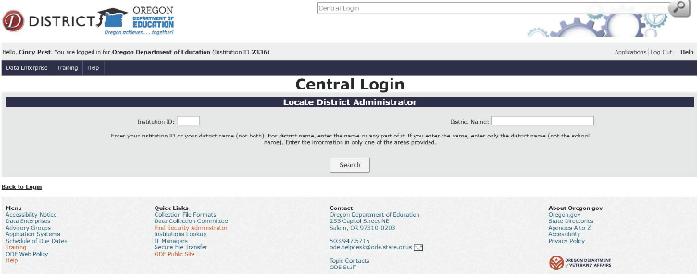
PSO App 2.0 Access
FOR FIRST-TIME USERS
Get permission from your SpEd or Student Services Director to access the PSO 2.0 Application
Locate your district security administrator for a password to access the application
Request submitter and modify rights for the application Special Ed Post School Outcomes 2.0
Access the secure district site: https://district.ode.state.or.us/apps/login/searchSA.aspx
Enter either your district name or Institution ID, this will allow you to search for your specific District Security Administrator who will give you your user name and password to login to the PSO Application (see next slide)
8

Slide 9
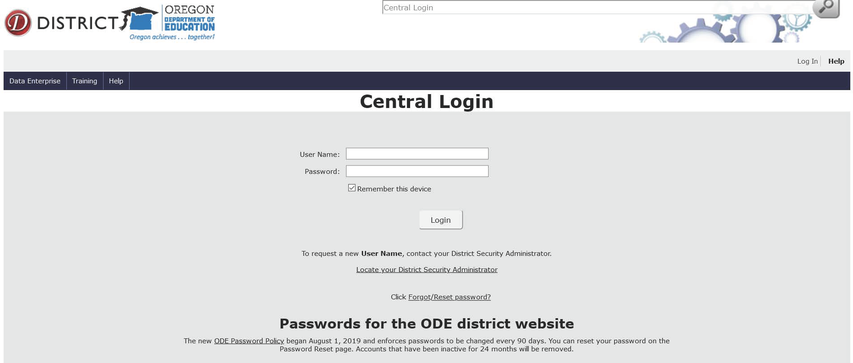
PSO App 2.0 Access
FOR REPEAT USERS
Gain access to your District site at https://district.ode.state.or.us/apps/login/default.aspx
Log in with user name and password
Click on: Special Ed Post School Outcomes 1.0-Oregon Department of Education
2.
2.
3.
9

Slide 10
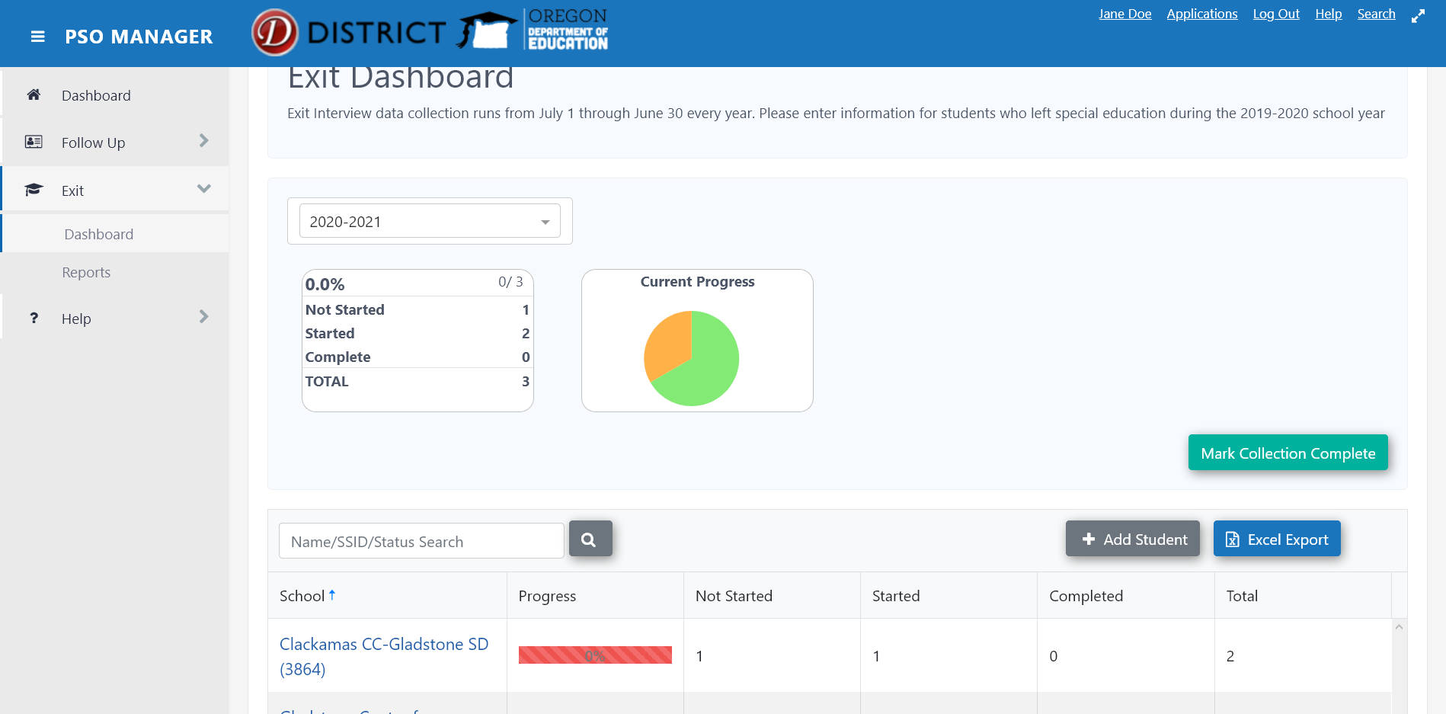
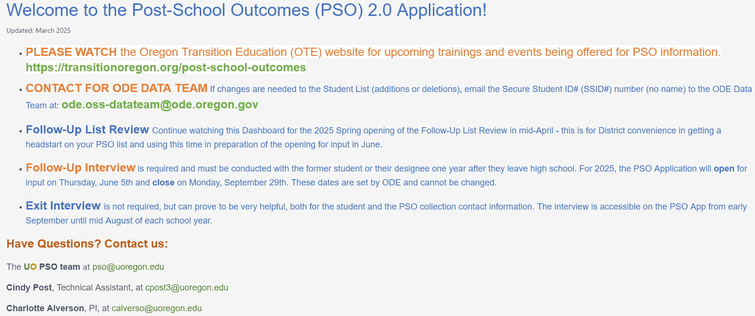
Welcome to PSO 2.0 App Home Dashboard
Help:
FAQs
Resources (links)
Agreement to participate
Exit Interview and Instructions
Follow-Up Resources
Additional Resources
Follow-Up:
Dashboard
Reports
Exit:
Dashboard
Reports
10

Slide 11
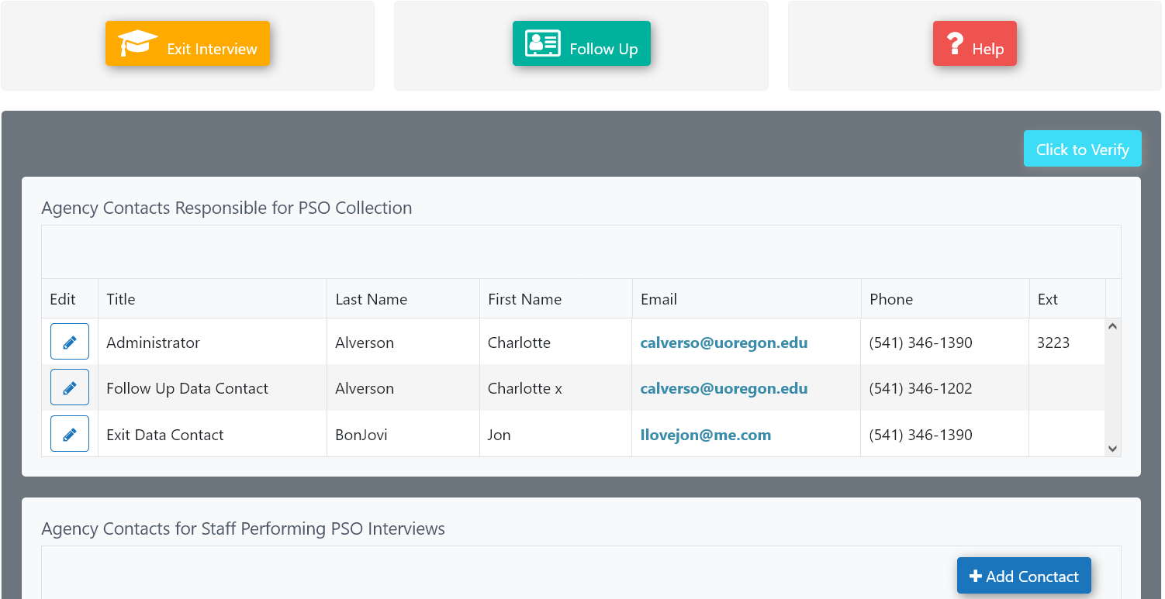



Home Dashboard and Navigation to the Exit Interview
If you continue scrolling down on the HOME Dashboard, please add your district/school contact information as well as contact information of the people that collect and/or input the data. When finished, click the
button to verify
before moving on.
To get to the interview portion, you can open the Exit Interview either with the
button or
by clicking Exit on the Dashboard Index.
11
Notes:
Here is where you can add your district/school contact information – both Administrative and those responsible for interviewing and/or input of the Exit/Follow-Up Interview

Slide 12
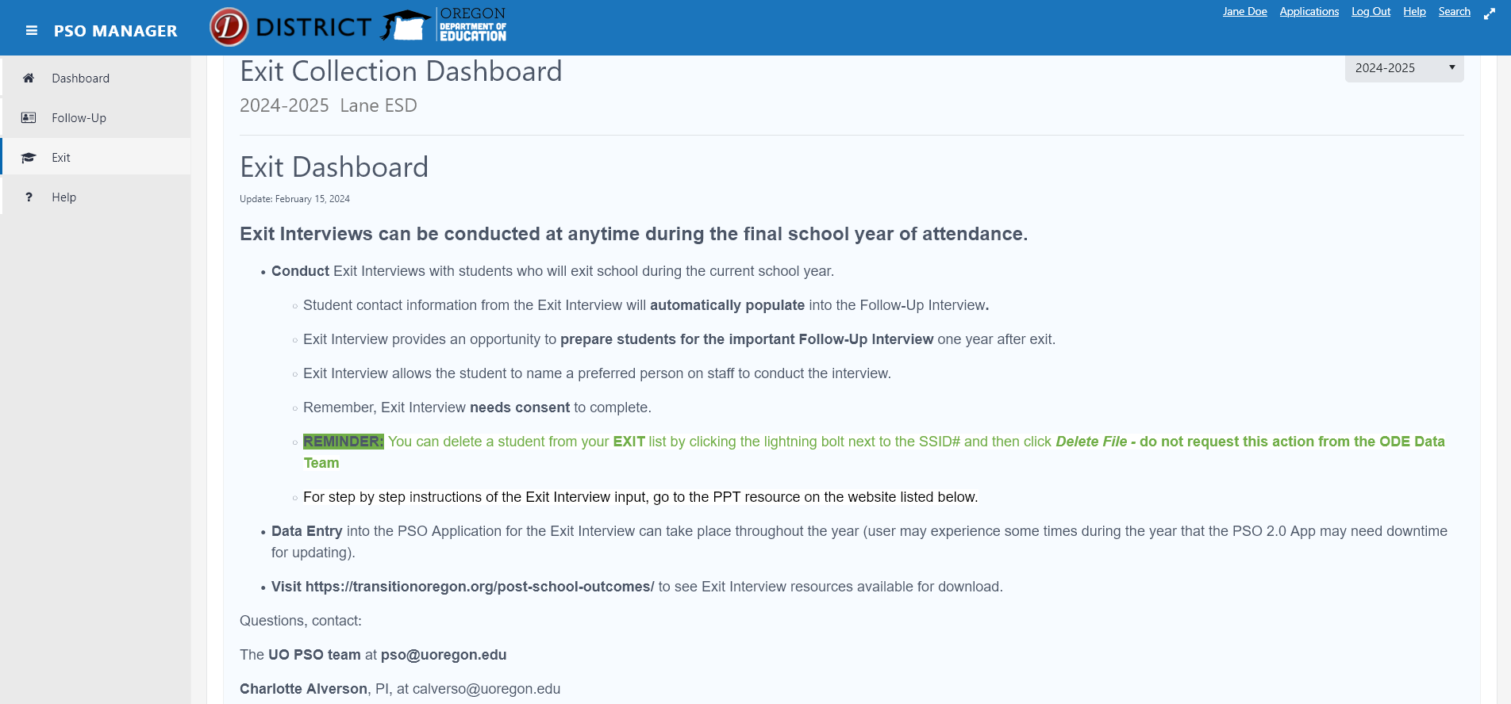
Exit Dashboard
12

Slide 13

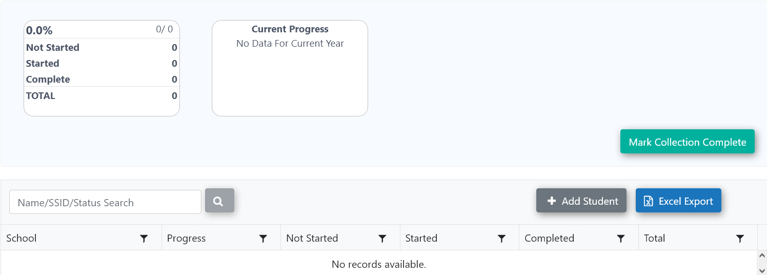
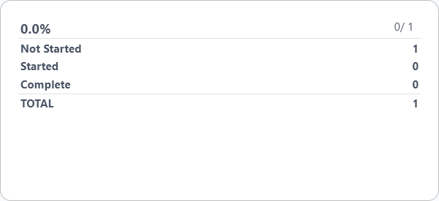
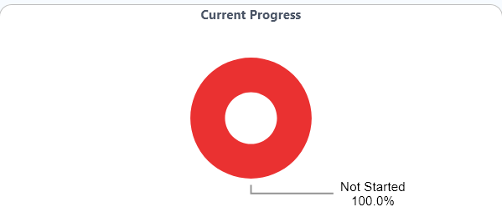
Exit Dashboard
The Exit Dashboard screen will show progress of Student Exit Interviews entered.
Once the student is added, either by doing an SSID search or clicking Add Student, a prompt will appear to enter the student information. The school will automatically be listed after a student is added. If your school is already listed, proceed with adding your student by clicking the school and then clicking Add Student.
Click Add Student, search by Student SSID# or Name
From this – (before data input)
To this - (after data input has begun)
(example from previous year input to show progress)
13

Slide 14
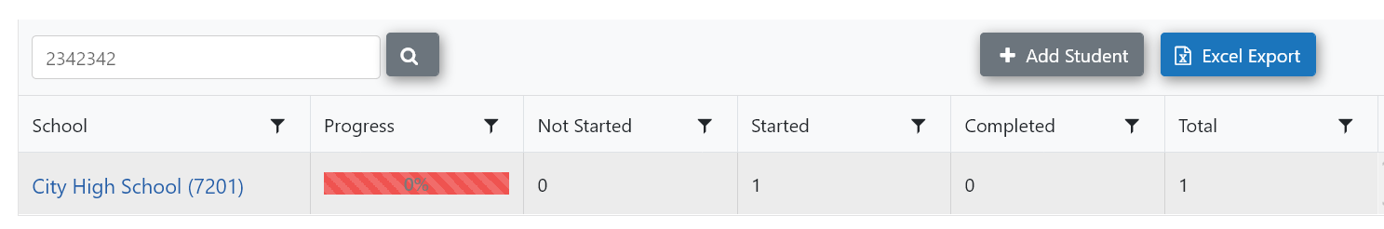
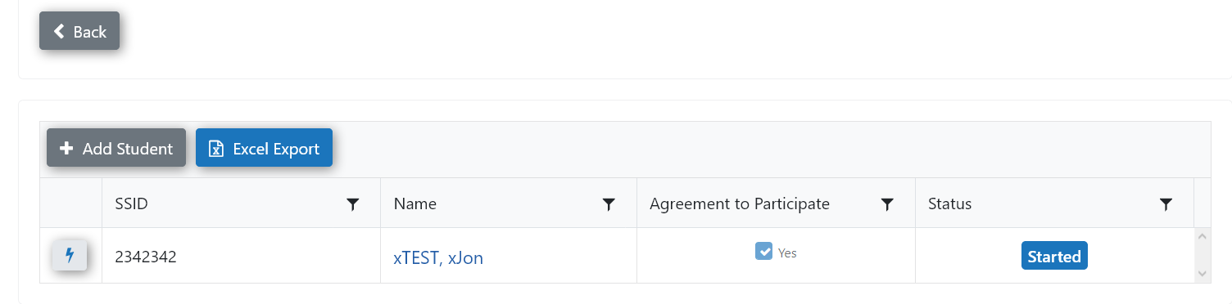
Add Students
Click on the High School name (above) to view the list of student(s) who have completed the Exit Interview.
The view (below) will show each student
that has been added
if the Agreement to Participate has been signed and
Student Status (Started, Completed, etc.)
More detailed steps for adding students/schools are in the upcoming slides
14

Slide 15

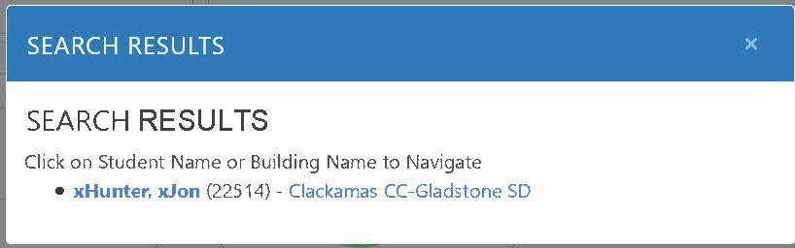
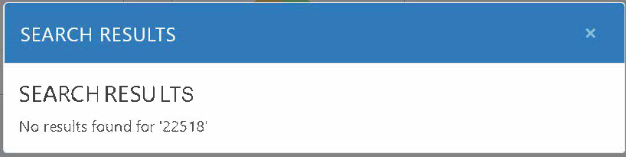
Search for Student
If a student is not on your list, you may use the search button in 2 ways.
If Found, a screen will appear -
Click on name and continue to Interview
By Name
OR
If NOT Found, a screen will appear - Go back and +Add Student
By SSID
15

Slide 16
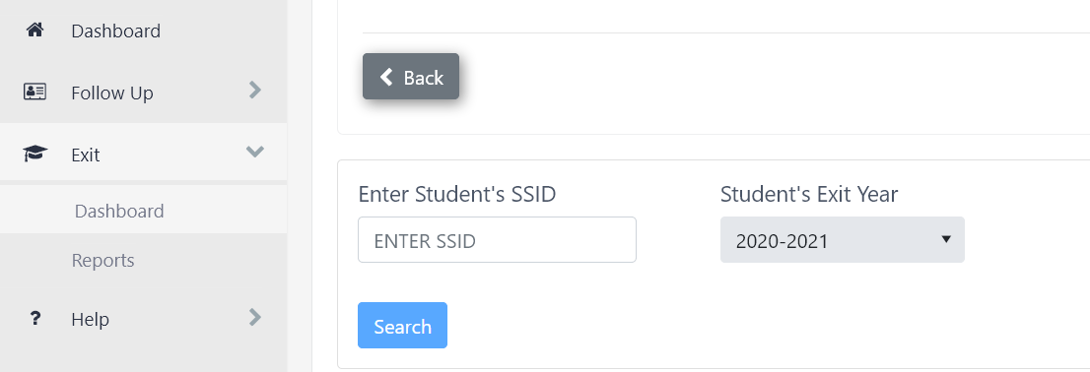
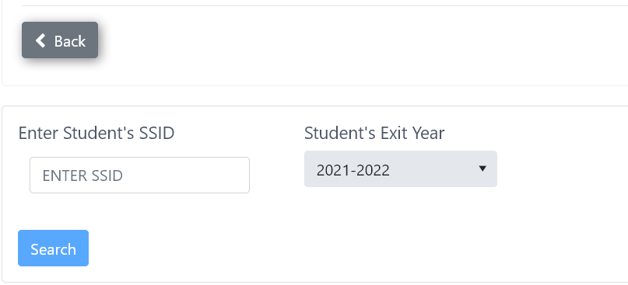
Adding New Student
2024-2025
Add new student by entering SSID and Student Exit Year and click
Search
Or, click the button from the previous page
+ Add Student
After adding student, confirm information is correct and press Save to continue
16
Notes:
Enter the student’s SSID # or name and then it will populate. Confirm the information is correct and press Save

Slide 17
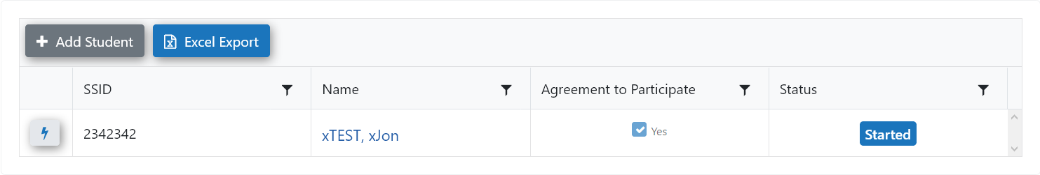
Enter Exit Interview
Click on student name to enter Interview portion
Continue to add students as needed
Reminder, don’t forget to obtain the Agreement to Participate
Documents are found on transitionoregon.org website under PSO Resources/Exit Interview
17

Slide 18
3 Sections of the Exit Interview
D
Demographics and School Participation-can be completed prior to the student interview and without Agreement to Participate D1-15
Can be entered at any time before the actual student interview
Q
The Student Interview Questions – CANNOT be completed without an Agreement to Participate Q0-12
C
Contact Information – can be completed prior to the student interview and without Agreement to Participate, ONLY IF it is information the district already has, otherwise, you will need a signed agreement for the student to answer and provide new contact information. D1-15
18

Slide 19
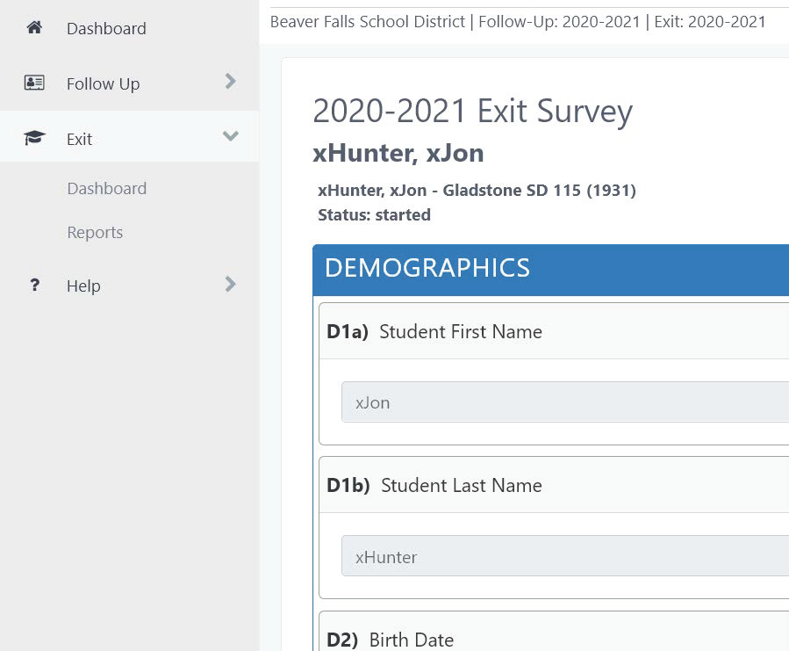
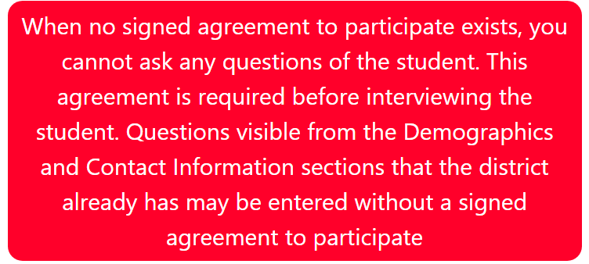
Demographics
2024-2025
Once in the survey, again, both the Demographic and Contact sections can be entered at any time. If you want to continue with the student interview, you have to have an Agreement to Participate on file.
When you come to the D12 question, (see below)
Does the student/parent/guardian agree to participate?
If the answer is no, or not sure, you will see this… and, you will not have access to the Q. section, the student interview section, that section will NOT appear for input until you have the Agreement to Participate on file and can answer Q12 as Yes
If Yes, please proceed…
19

Slide 20
Demographics
Descriptor Button
In the Demographics section only, you may come across a question button.
Once clicked, a short description will be revealed regarding the demographic question;
re-click to remove the provided explanation, see examples below:
D3: Gender
D7: Anticipated Method of Exit D12: Does the student/parent/guardian agree to participate?
?
ODE added a non-binary option for students, X = Non-Binary
For students in transition programs, this should be the student's actual method of exit.
If the student is 18 or older, they must sign an agreement
to participate, otherwise their parent/guardian must
sign an agreement to participate.
20

Slide 21
Student Interview Questions
STUDENT FUTURE PLANS
In the first part of this Q-section, you will encounter Questions 1-11. These are mostly regarding the student’s future plans.
Interview must be completed with the student
This interview may occur with parents during an IEP meeting
Allow this interaction to prepare the student and family for the required Follow-Up Interview that will happen one year after exit from high school
21

Slide 22
Student Interview Questions
AGENCIES AND SERVICES
The final questions of this student interview are Questions 12a-12g.
These questions are directed towards the student’s knowledge of agencies and services for assistance.
Assist the student with any future needs or questions regarding agencies and services
Have resources available to be able assist students with services in their future
22

Slide 23
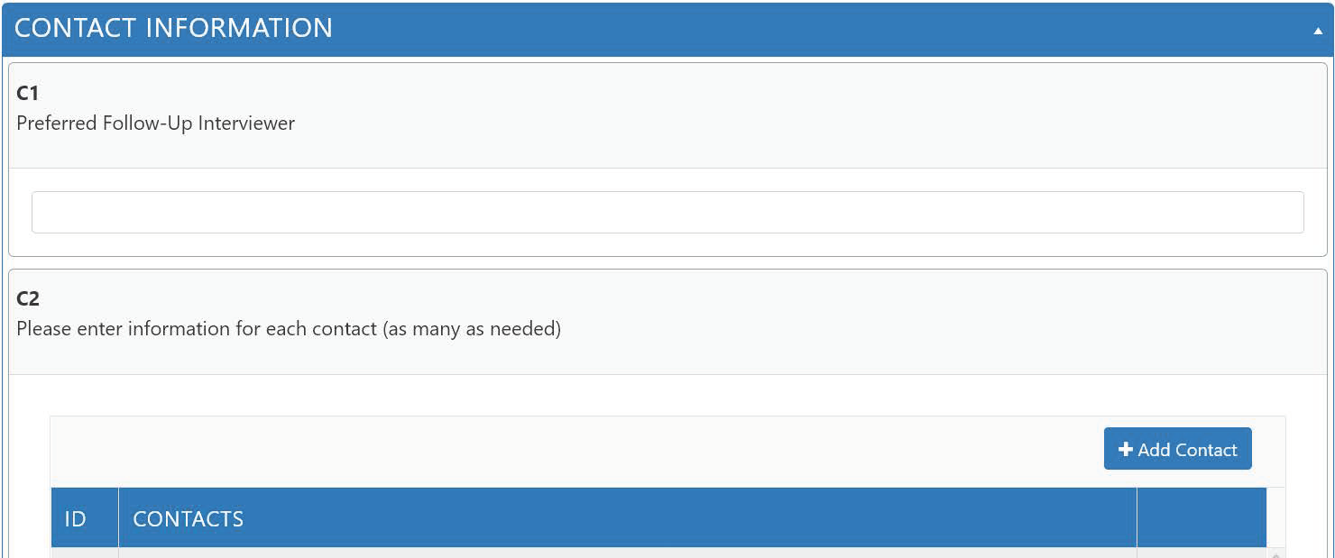
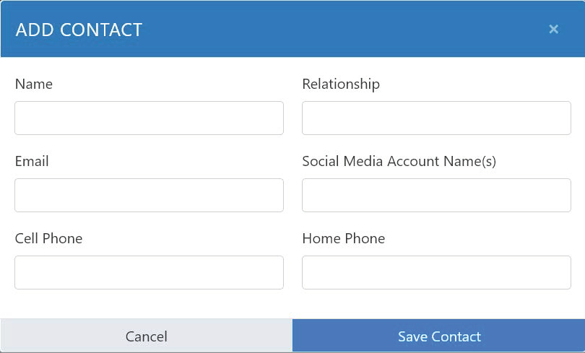
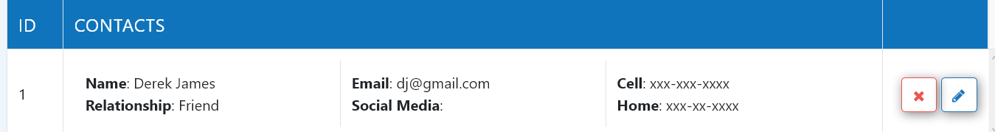
Contact Information
CONTACTS Section, C1-C5
Have the student continue with this section-their input will be extremely helpful
Beginning with the student and carrying through to a close friend, contacts are a VERY IMPORTANT part of the Exit Interview
This collection will provide helpful contact information for the Follow-Up Interview
Collect as much information as you can during this opportunity
An additional question to ask is:
Is there someone in particular you would like to choose to conduct your Follow-Up Interview? Enter name into Preferred Follow-Up Interviewer (C1)
Remember to click after each addition
Save Contact
This is result the of adding Contact info
23

Slide 24

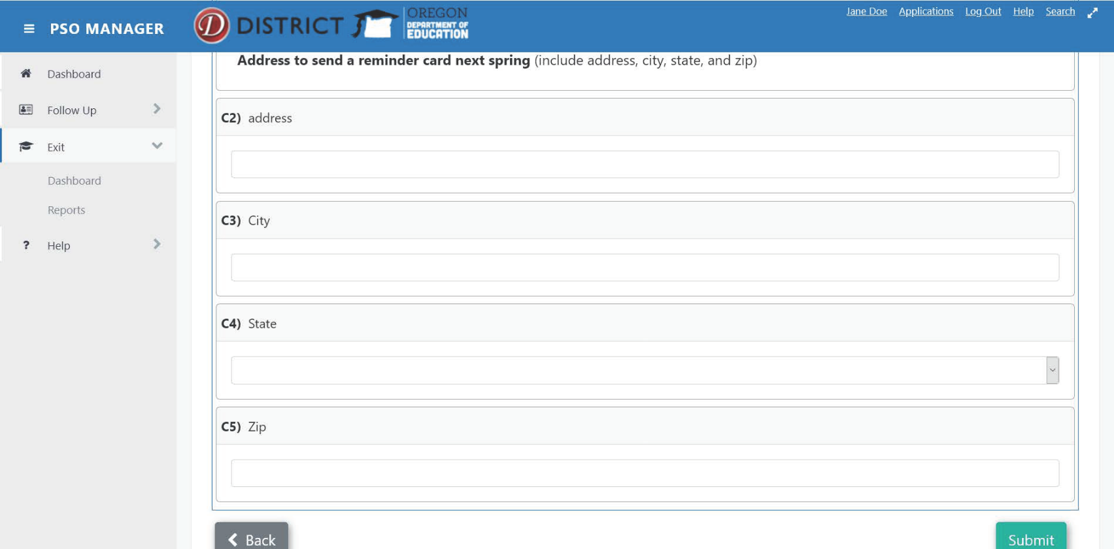
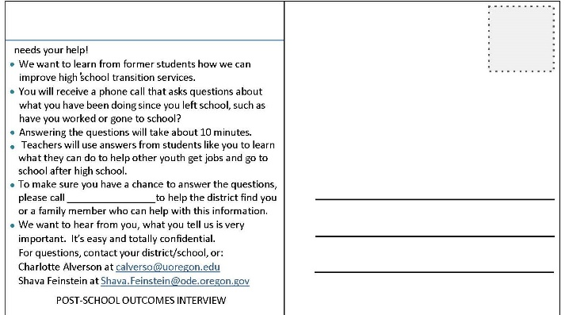
Contact Information
Enter the Postcard information in the
PSO Exit App if this is a new address
The PSO Postcard
Introduce the student to the postcard
Familiarize student with the item that will remind them of the upcoming important Follow-Up Interview
Have them personally address a PSO postcard to themselves
Both English and Spanish versions are found on the
OTE website under:
https://transitionoregon.org/post-school-outcomes/exit-interview/
24
Notes:
While still in school, discuss the upcoming Follow-Up Interview with students
Share what district has learned from past students and how their input can be helpful in the future
Have students complete the PSO postcard to themselves

Slide 25
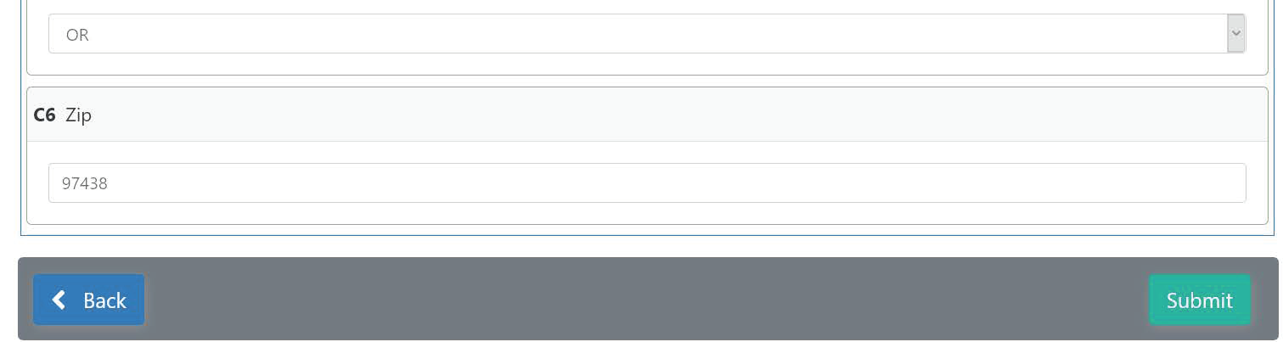
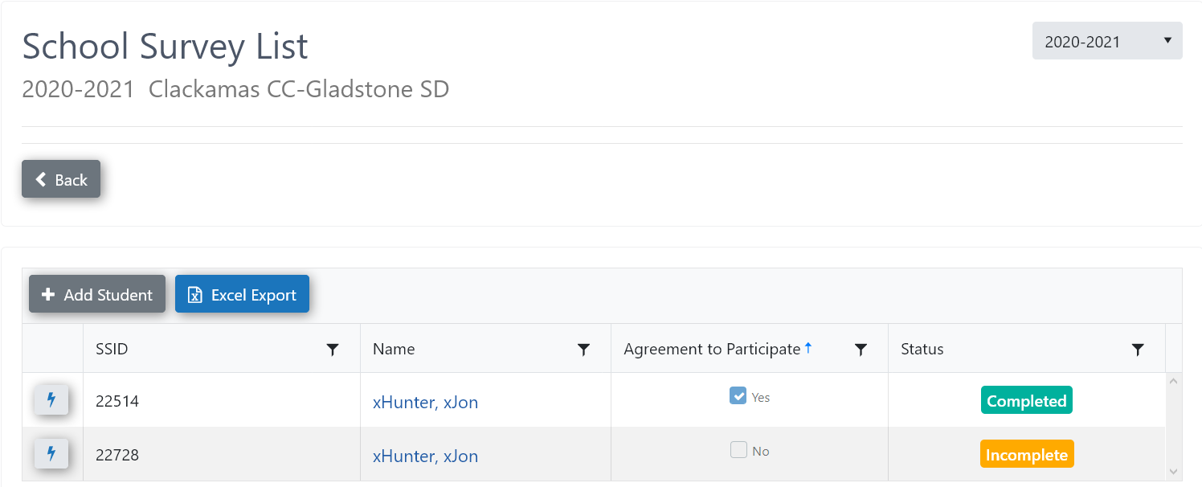

Submission Process
Submission of Information:
When you are totally complete, click
Submit
If you need to return and continue working on your interview, you can return and do so by clicking on your student name and continuing
< Back
Use the Back button to return to the main Dashboard, your interview record will show Incomplete for this student
After completing and submitting your interview
You can return to your interview for any edits or updates that are needed
To do so, click
and proceed with edits or revisions
Click button when done
Unlock Completed Interview
Submit
25

Slide 26
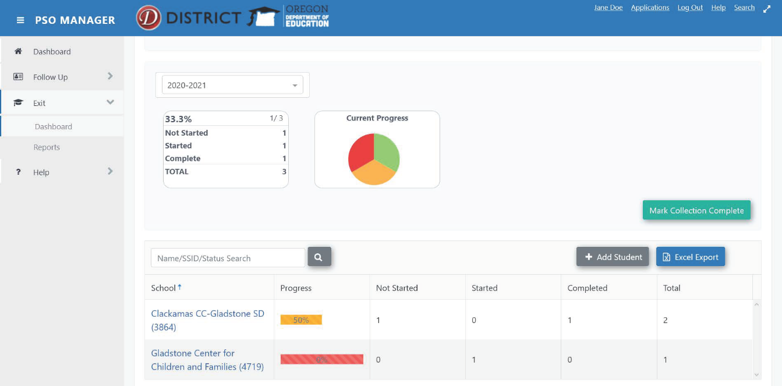
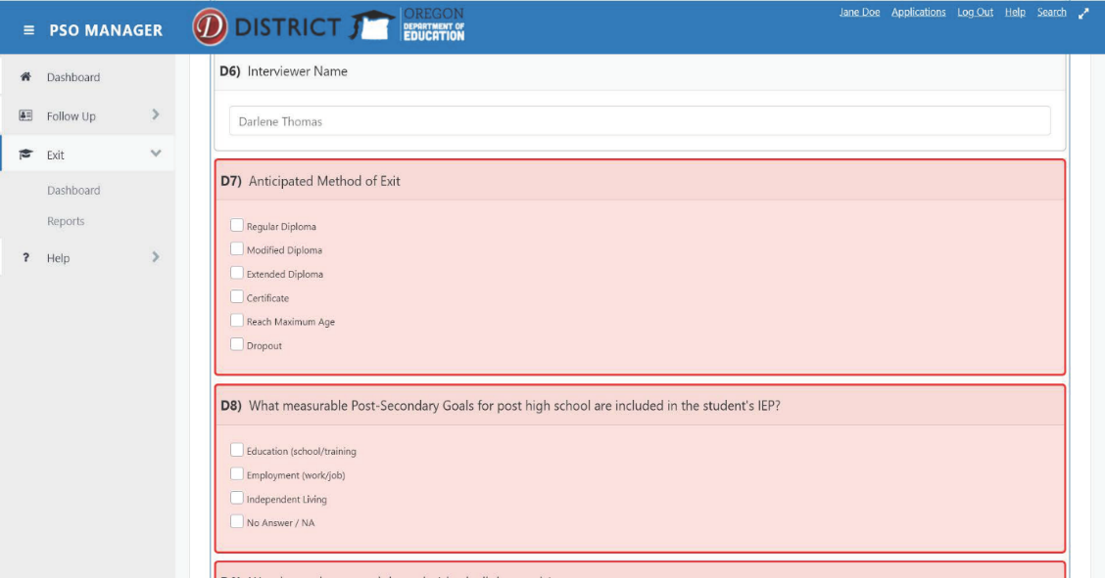
Submission Process
If you see the questions highlighted in red (as below), this may indicate one of the following issues:
Completion needed
Saving or submitting is necessary
Interview is closed and needs to be unlocked to complete
If completing all of the questions does not
resolve this issue, please ask for assistance
District Progress Bar – % of total students entered, will show for individual Schools and District progress will show in the pie chart.
Completed
Started
Not Started
Total
2024-2025
26

Slide 27
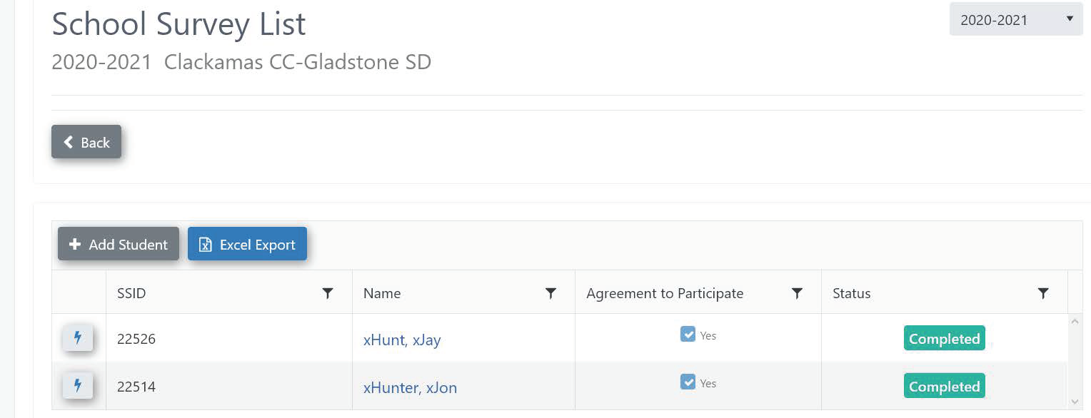

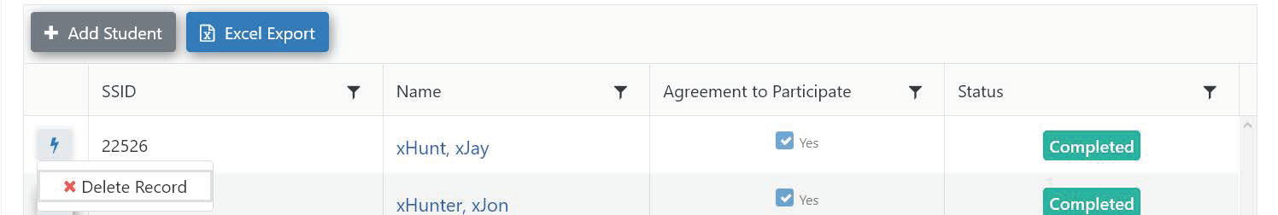
Submission Process
Upon final review, if you see a duplicate or a need to delete a file, please follow the 2 steps below:
2024-2025
2024-2025 Lane School – Lane ESD
Please click on the button
Click the button, a button will appear, click to delete this file
X Delete Record
27

Slide 28
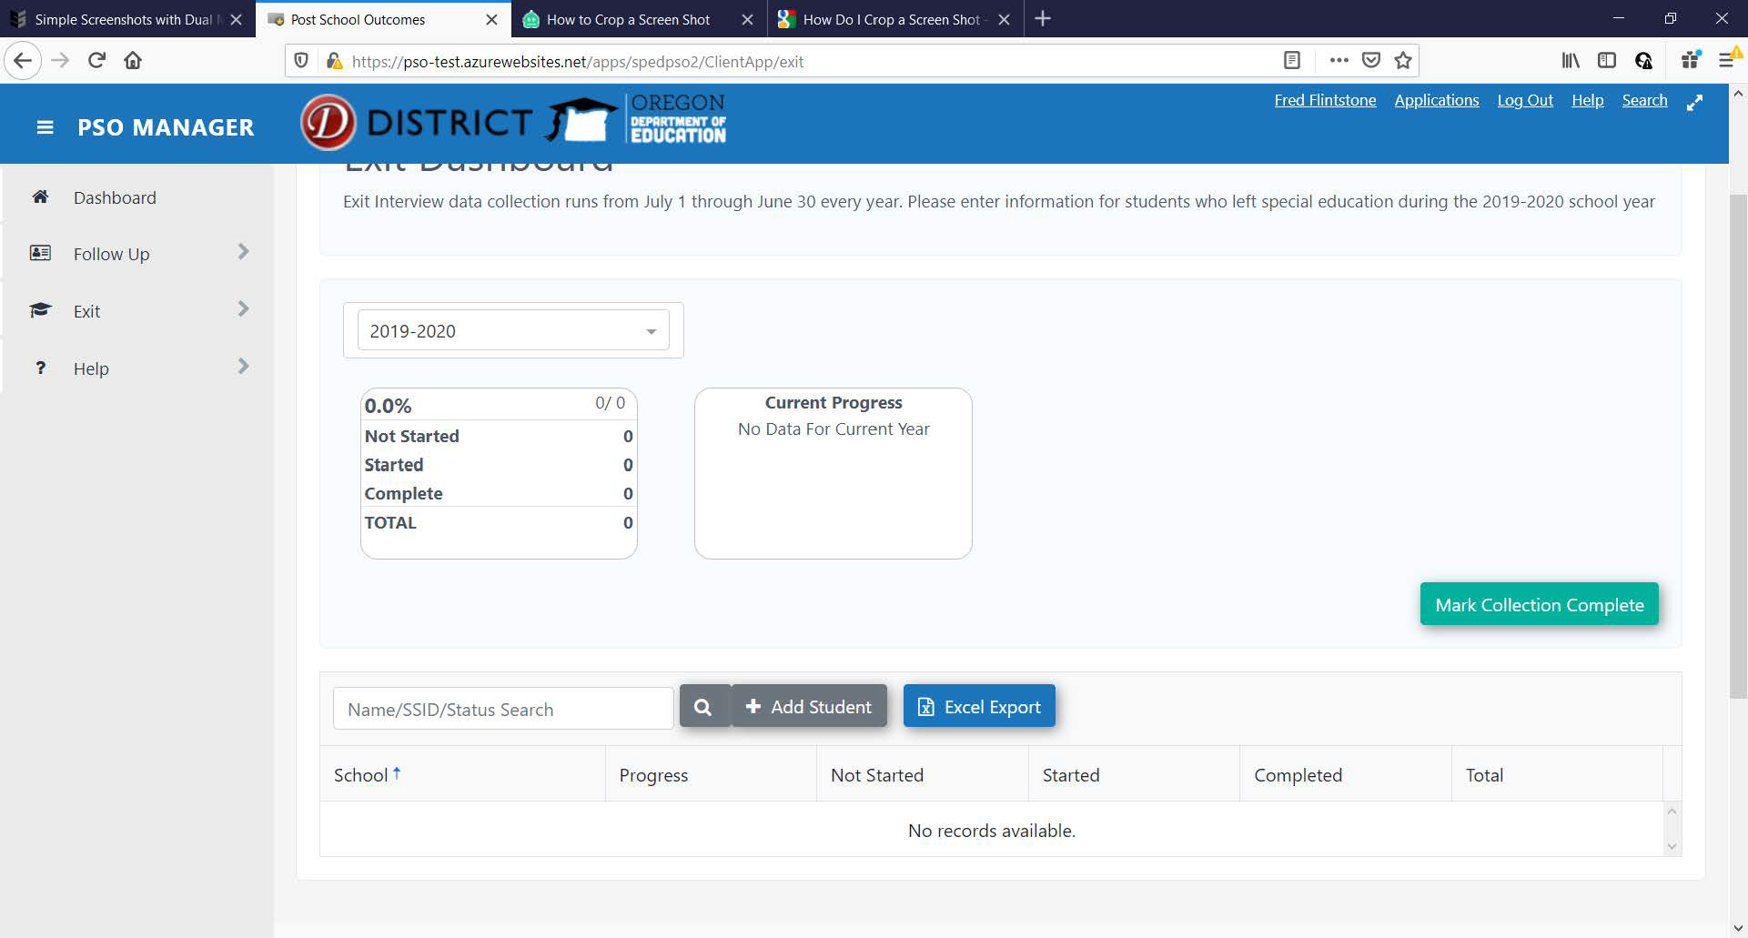
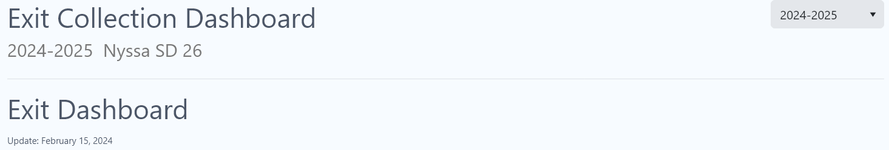
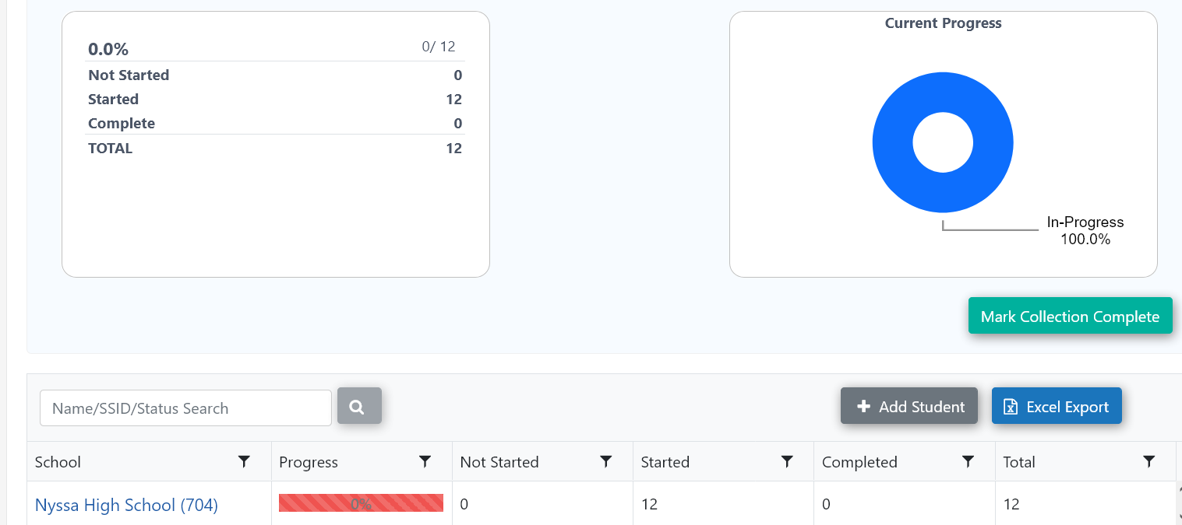
Submitting ALL Completed Exit Interviews
Completion of ALL input:
Check to make sure all students who are going to be interviewed are input completely
Delete any interviews that have been duplicated
Once your district lead has confirmed completion, and you will no longer plan to make any changes to an interview, click
for the current year
2024-2025 Lane School – Lane ESD
Mark Collection Complete
Lane School
If you click the Excel Export button, you have access to a download an excel file of all students’ interview data
28

Slide 29
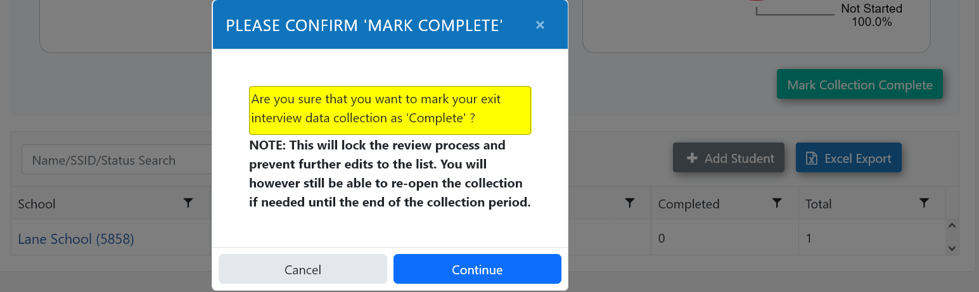
Edits to Exit Interview(s) Once Marked Complete
If you find you need to make necessary edits to your Exit Interview, just click Unlock Completed Interview and proceed with your edits.
Reminder: You CANNOT edit SSID# or Attending School ID – all other data can be edited.
After editing, click Submit once again and Confirm completion with clicking Mark Collection Complete
29

Slide 30
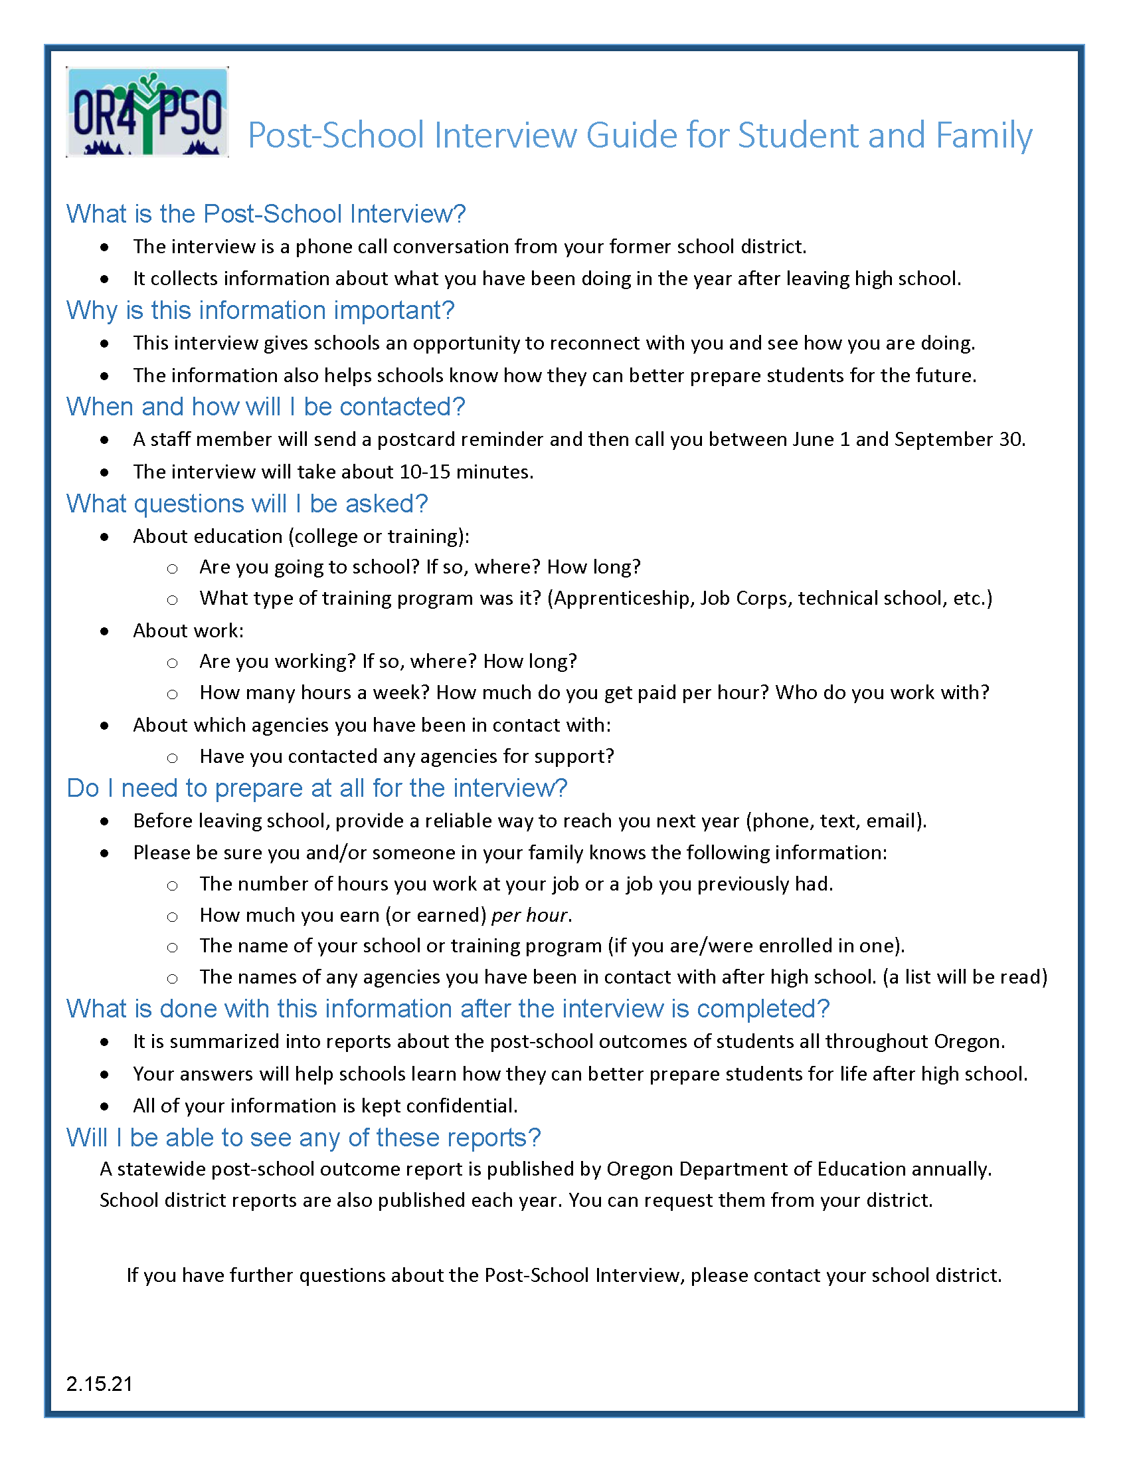
Exit Interview Resources
Resources:
Exit Interview (English, Spanish, Pdf fillables)
PSO Interview Guide for Student and Family
Agreements to Participate (English/Spanish)
PSO Postcard (English/Spanish)
Found on the Oregon Transition Education
Website:
under PSO Resources/Exit Interview at:
https://transitionoregon.org/post-school-outcomes/exit-interview/
Post-School Interview Guide for Student and Family
Use as an informational handout for students/parents/ guardians when requesting the Agreement to Participate
Use during the Exit Interview, along with PSO Postcard, as an introduction to the upcoming Follow-Up Interview for the student
Distribute at IEP meeting in preparation for both the EXIT Interview and the required upcoming Follow-Up Interview one year after exit from school
30

Slide 31

The Exit Interview is a great connection!
For help or technical assistance please contact:
pso@uoregon.edu
Charlotte Alverson calverso@uoregon.edu
Shava Feinstein Shava.Feinstein@ode.oregon.gov
Cindy Post
cpost3@uoregon.edu
You will find this training PowerPoint, the Exit Interview , Postcards
and many other resources on:
https://transitionoregon.org/post-school-outcomes/
31
Notes:
Thank you for your PSO work and support!

