Slide 1
The Results Are In: Post-School Outcomes for Students who Left School in School Year2023-2024
PSO Team
University of Oregon
February 2026
On behalf of Oregon Department of Education
Notes:
PSO Team: Charlotte Alverson, Cindy Post, Jackie Burr, Jesse Berkey

Slide 2
Oregon’s One Year Follow-Up Interview
Students who had an IEP in effect when they left secondary school are contacted one year later to learn whether they went to an education or training program or worked since leaving school.
These data must be collected for all students.
Learning what students did after leaving secondary school helps identify what is and is not working of students.

Slide 3
One Year Follow-Up Interview Timeline
Student leaves secondary school
Has 365 days to enroll in college or a training program or go to work
Former student or their family is contacted for the Follow-Up Interview starting in June
Data reported here were collected in summer 2025 from students (or their families) who left secondary school during the 2023-24 school year.

Slide 4
How Oregon Collects PSO Data
Interviews, recorded in the PSO 2.0 App, are conducted by school personnel
31% Teacher – Specialist
27% Secretarial-Clerical Staff, Admin. Assistant, Program Support, Data Specialist
25% Specialist: YTP, Transition, Employment
13% Assistant: Education, Instructional, Paraprofessional
4% Administrators
<1% Other
Interviews are conducted with all former students (a.k.a., leavers or exiters) who have been out of school for at least 1-year:
Graduated
Dropped-out
When: June – September 2025
Reached Maximum Age (aged-out)
Were Expected to Return, but did not

Slide 5
Outcome Category Criteria
Higher Education
enrolled full- or part-time
Competitive Employment
worked for pay at or above the minimum wage
Other Postsecondary Education or Training
enrolled full- or part-time
Other Employment
worked for pay or been self-employed
community college (2-year program)
college/university (4- or more year program)
1 complete term
setting with others who are nondisabled
20 hours a week
90 days at any time in the year since leaving high school
includes military employment
90 days at any time since leaving high school
includes working in a family business (e.g., farm, store, fishing, ranching, catering services, etc.)
education or training program (e.g., adult education, vocational technical school that is less than a 2-year program)
1 complete term
To be counted in an outcome category, all criteria must be met for that category.
If former students meet criteria for two or more outcomes, they are counted in the highest category.
Notes:
Notes: These definitions are specific to Indicator 14 measures.
Youth meeting criteria in two or more categories are counted in the highest category

Slide 6
2025 Data Collection Efforts
5,126 Total School Leavers
566 leavers refused to be interviewed or ended the interview early
1,884 leavers could not be contacted
No contact information or Wrong contact information
No response – contact information was valid, a message was left, no response received, or no answer
No attempt to contact – no questions answered
2,676 Completed Interview
Notes:
Total Leavers Eligible Leavers Completed Interviews
FFY20 4,917 4,847 2,775
FFY21 4,655 4,601 2,782
FFY22 5,572 5,435 2,866
FFY23 5,138 5,007 2,855
FFY24 5,126 2,676

Slide 7
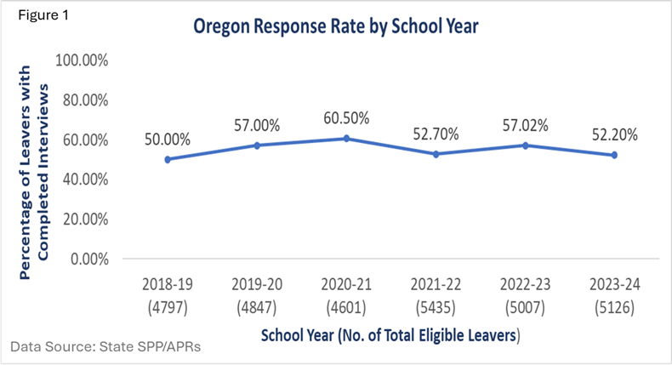
Response Rate tells how many people completed the Follow-Up Interview
Of the 5,126 leavers in SY2023-’24, 2,676 former students or families completed the Follow-Up Interview.
52.20% response rate
Respondent | Number | %
Former Student | 1326 | 49.55%
Family / Designee | 1272 | 47.53%
Other | 78 | 2.91%
Total | 2676 | 100%

Slide 8
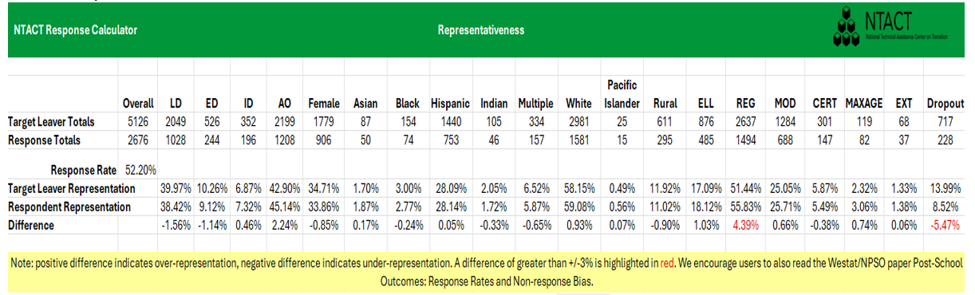
Representation tells how similar those who completed the Follow-Up Interview are to the total population of leavers.
Compare key characteristics of those who responded to the total leavers to determine which groups of former students are accurately reflected in the results.
A difference greater than +/- 3% between Target Leaver Representation & Respondent Representation is important
In 2025, former students who dropped out of school were under-represented (-5.47%), and those who obtained a regular diploma were over-represented (4.39%).
Results represent leavers based on disability category, gender, race/ethnicity, urban/rural, and ELL
LD = Specific Learning Disability; ED = Emotional Disturbance; ID = Intellectual Disability; AO = all other disability categories

Slide 9
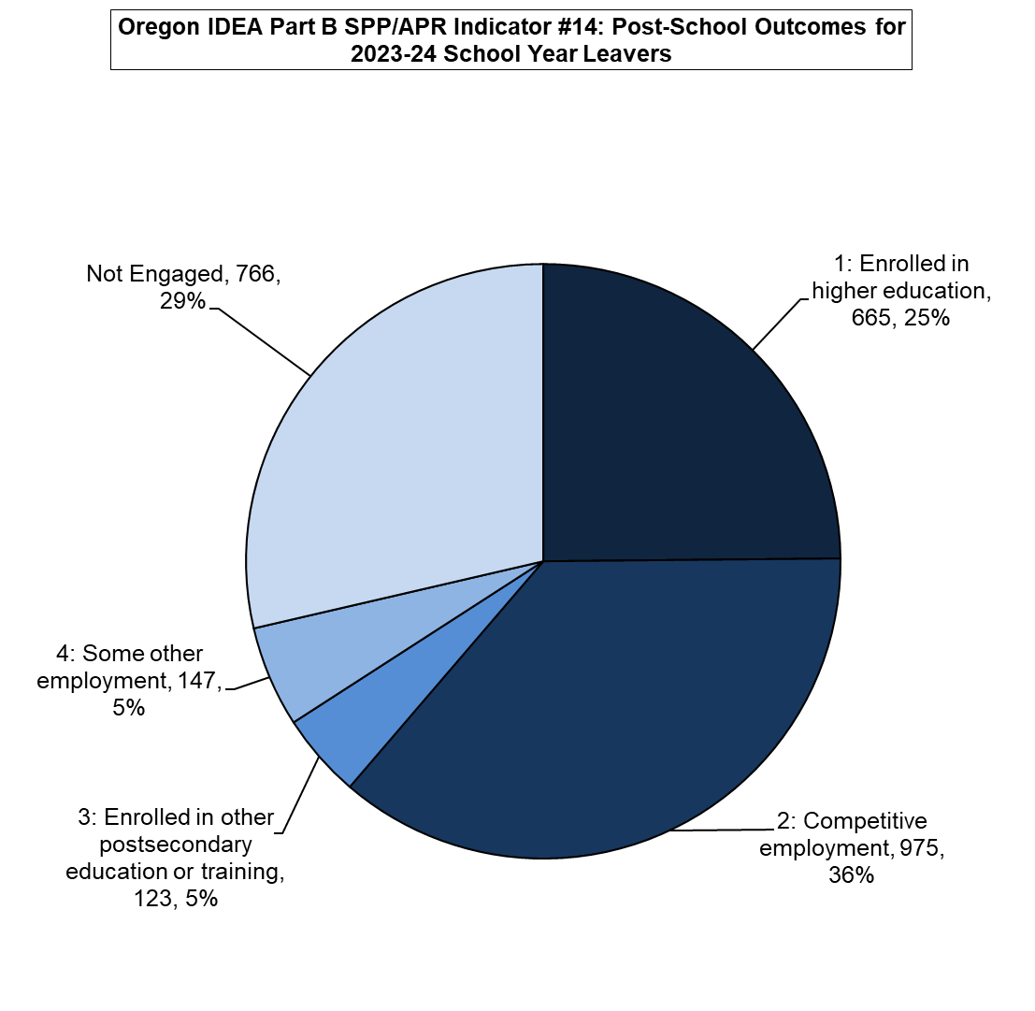
Results for Leavers in School Year 23-24
Total Respondents
2,676 (52.20%)
Total Engaged
1,910 (71.38%)
Not Engaged
766 (28.62%)
Notes:
Year Total Leavers Total Respondents Total Engaged Not Engaged
FFY20 4847 2775 2001 (72%) 774
FFY21 4601 2782 2100 (75.5%) 682
FFY22 5435 2866 2135 (74.5%) 734
FFY23 5007 2855 2103 (73.66%) 752

Slide 10
5 Outcomes become 3 Engagement Rates: A, B, C
Five outcome categories, 1 – 5, are combined into three engagement measures: A, B, C
1 = # Higher Education | 2 = # Competitive Employment | 3 = # Postsecondary Education or Training | 4 = # Some Other Employment | 5 = # Other or Not Engaged (States are not required to report this number, but it is in the denominator.)
A = 1/Total Respondents
B = 1 + 2 / Total Respondents
C = 1 + 2 + 3 + 4 /Total Respondents
Total Respondents

Slide 11
Oregon’s Engagement Rates for Measures A, B, & C
Engagement Category | Frequency/ No. of Respondents | Percent | Measure A | Measure B | Measure C
Higher Education | 665 | 24.85% | 665 (24.85%) | 1640 (61.29%) | 1910 (71.38%)
Competitive Employment | 975 | 36.43%
Other Postsecondary Education/ Training | 123 | 4.60%
Some Other Employment | 147 | 5.49%
Not Engaged | 766 | 28.62%
TOTAL | 2676 | 100%

Slide 12
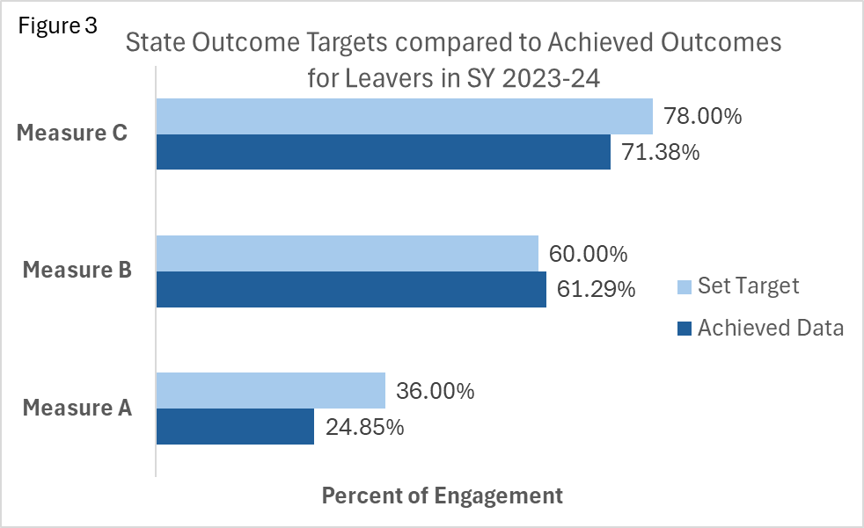
Oregon Targets The state must set targets for each Measure.
Measure C: The target of 78.00% (n = 2,088) was not met.
178 additional former students statewide needed to be engaged to meet the target
Measure B: The target of 60.00% (n = 1,606) was met.
Measure A: The target of 36.00% (n = 964) was not met.
299 additional former students statewide needed to be enrolled to meet the target.
Number needed to reach target is based on 2,676 leavers.

Slide 13
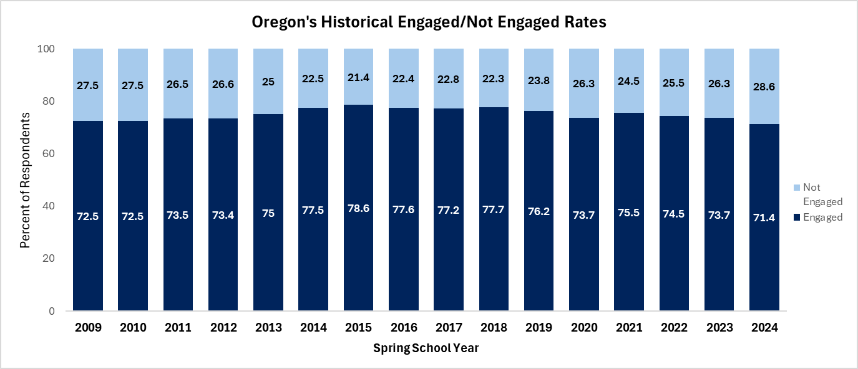
Historical Engagement/Not Engagement

Slide 14
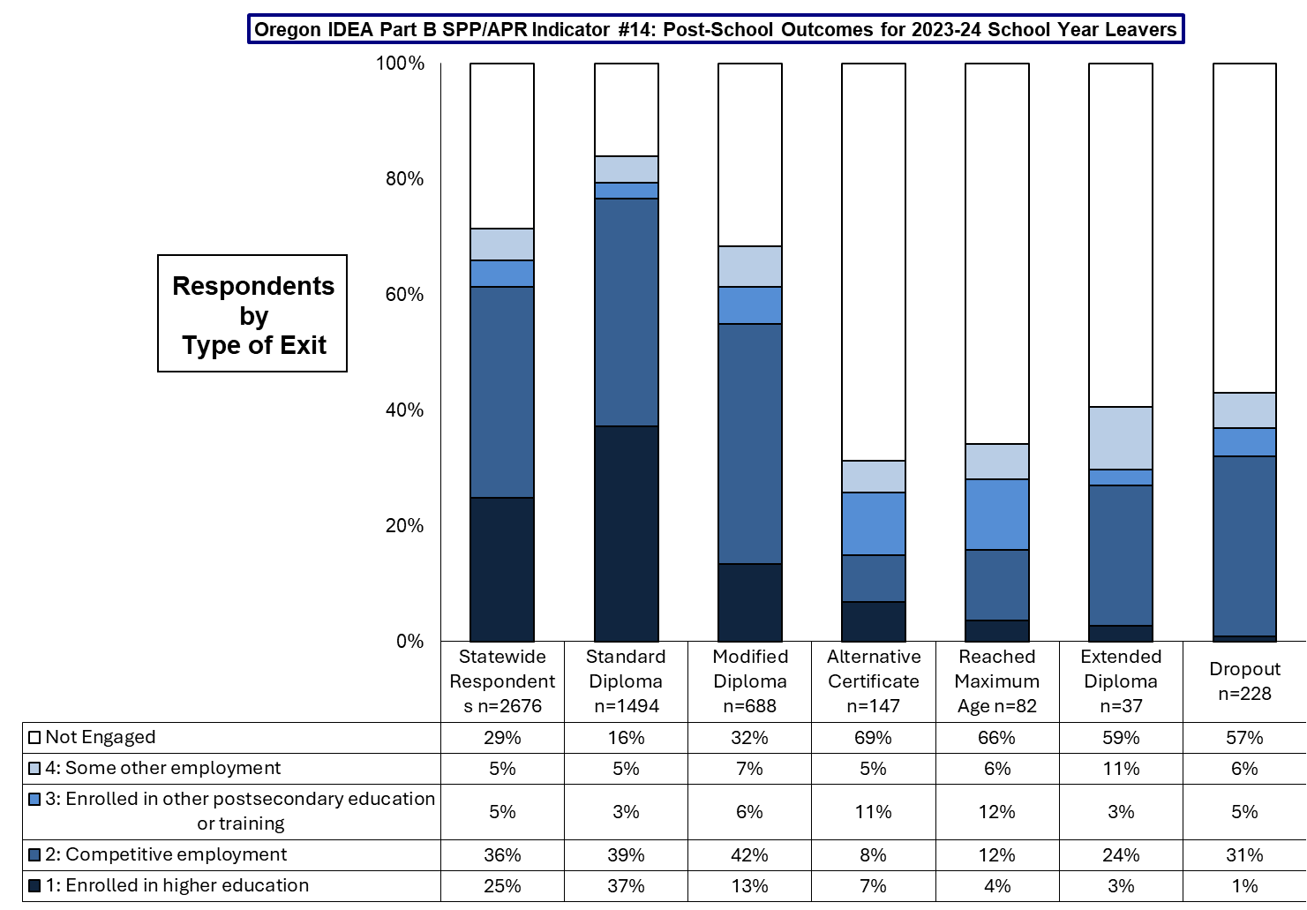
By Type of Exit,
84% of former students who achieved a standard diploma were engaged overall;
37% had enrolled in higher education, and
39% were competitively employed since leaving high school.

Slide 15
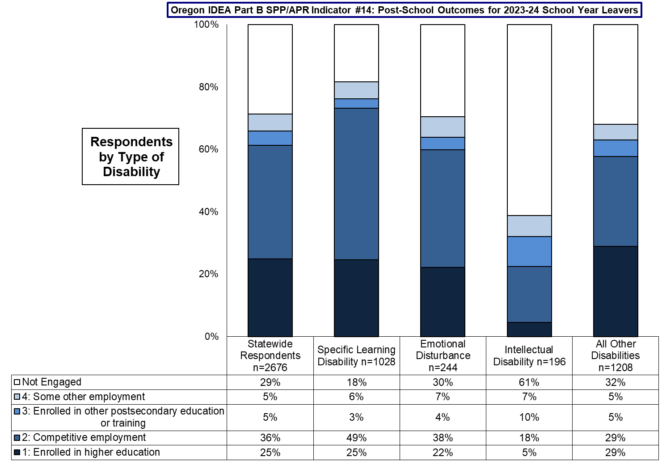
By Type of Disability,
82% of former students who received services for a specific learning disability were engaged overall;
25% had enrolled in higher education, and
49% were competitively employed since leaving high school.

Slide 16
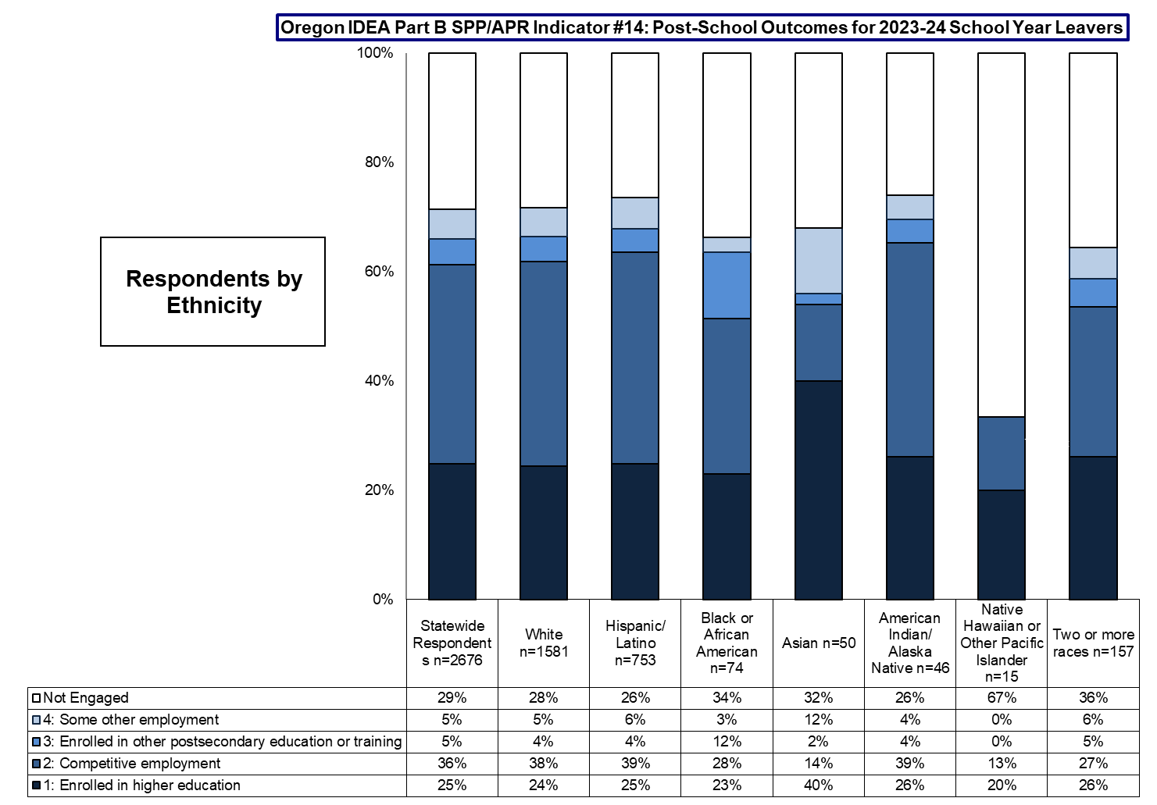
By Race/Ethnicity,
74% of former students who were either Hispanic/Latino or American Indian/Alaska Native were engaged overall;
39% of Hispanic/Latino and 39% of American Indian/Alaska Native former students had enrolled in higher education, and
25% of Hispanic/Latino and 26% of American Indian/Alaska Native former students were competitively employed after leaving high school.

Slide 17
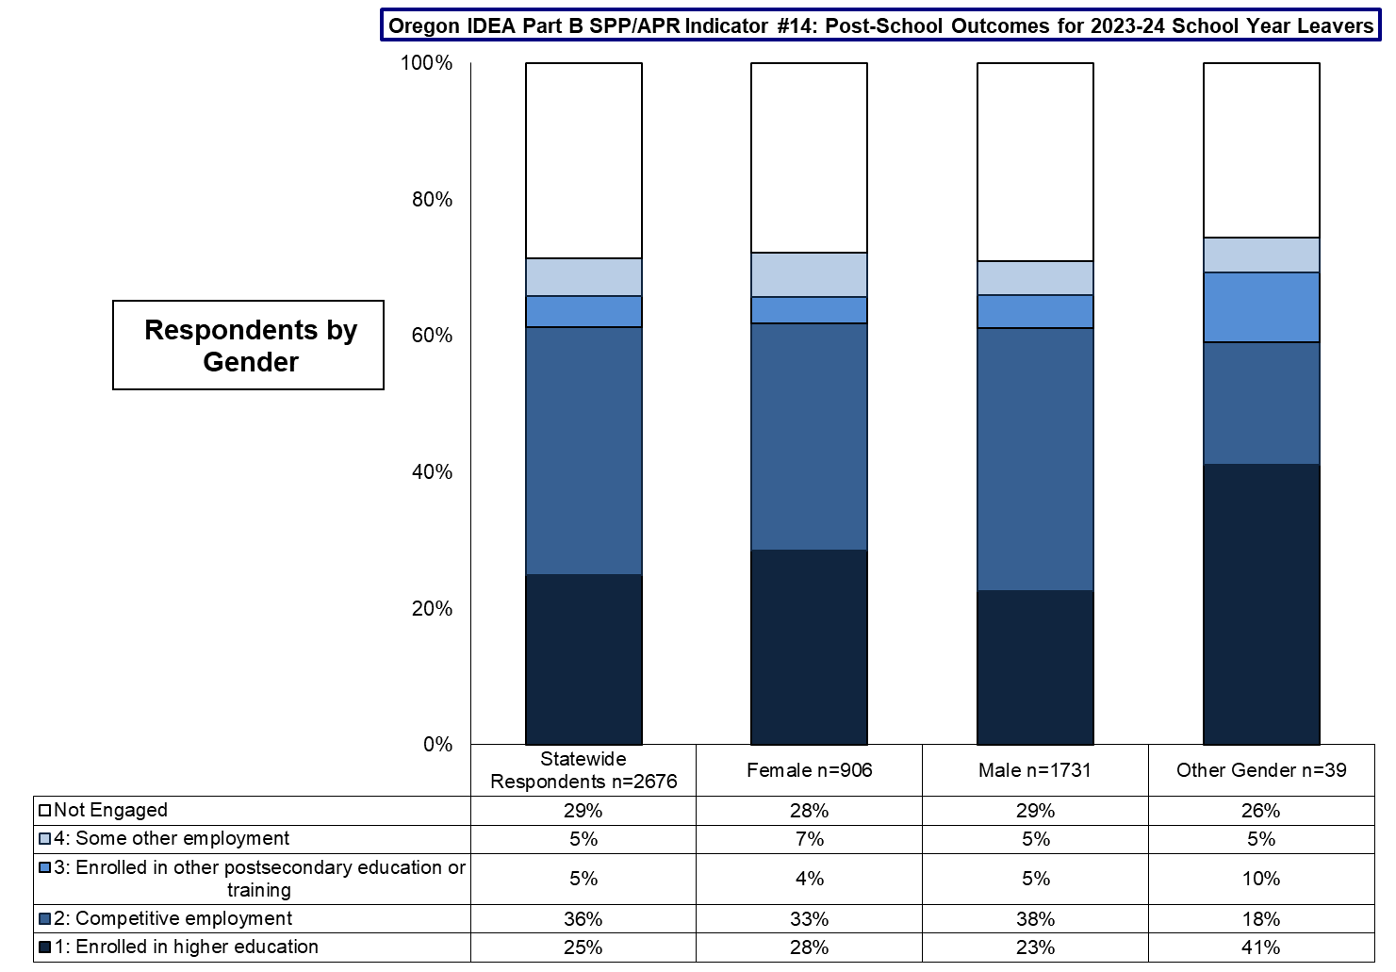
By Gender,
71% to 74% of former students, regardless of gender, were engaged overall;
41% of former students who identified as Other Gender were enrolled in higher education,
38% of former students who identified as mal, and
33% of former students identified as female were competitively employed after leaving high school.

Slide 18
Using PSO Data to Improve Transition Services
Data Quality Questions to Consider
What was our response rate and was it better or worse than last year?
Are interviewers making multiple attempts on multiple days and at different times to reach former students?
Are interviewers conducting an optional Exit Interview before the student leaves school?
How representative were respondents compared to total leavers?
Which student group is not responding to the interview?
How can we get students who dropout of school to respond to the Interview?
Are we getting multiple forms of contact information?
When do we tell students and families about the Follow-Up interview?
Who conducts the interviews and are they trained in the interview process?
How can we improve data quality?

Slide 19
Using PSO Data to Improve Transition Services
Questions to Ask about Outcomes
How do outcomes this year compare to previous years?
Which student groups are engaged/not engaged?
Why and why not – what influences engagement of our students?
How do we provide transition services for all students who receive special education services?
Are we implementing the strategies that have been shown to predict post-school success?
Are our students enrolled in career and technical education?
Are our students participating in Pre-Employment Transition Services?
How do we provide work-based learning opportunities?

Slide 20

Districts can access their PSO through the SPR&I system
Student List Review will be available April 16, 2026
PSO App 2.0
Opens first Thursday in June – 6/4/26
Closes last Monday in September – 9/28/26

Slide 21
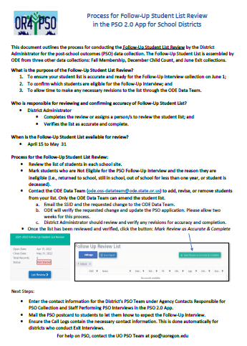
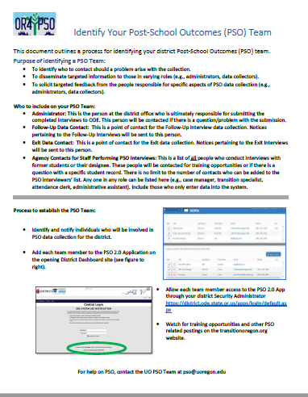
Resources:
For all PSO resources, visit the Oregon Transition Education (OTE) website: https://transitionoregon.org
1-Pagers:
Identify Your Post-School Outcomes Team
Process for Follow-Up Student List Review
What is Consent?/What is a Refusal?
Understanding Follow-Up Interview Dates
Advantages of the Exit Interview
Watch for Just-In-Time videos to accompany the 1-page resources

Slide 22
Save the Dates: PSO Trainings 2026
Date/Time of Live Events Title | Audience | Objective | Mode
February 20, 2026 The Results are In: PSO Results from 2025 | All Interested Parties | To share results from students who exited school in 2023-24 school year | Recorded only Posted on www.Transitionoregon.org
March – OSTC | Anyone responsible for postschool outcome (PSO) data collection, reporting, or use. Check the OSTC materials for the time and location of PSO presentation/s. |  | In person at OSTC in Eugene
April 22, 3:15 pm – 3:45 What’s New in 2026: Just the Facts for Veteran Data Collectors | Interviewers & administrators experienced in collecting and reporting PSO data | To provide an overview of PSO any new processes and resources for 2026 | Live- Virtual via Zoom
May 14, 2026 @ 3:00 pm ODE Spring Webinar | By ODE invitation – Watch for notifications from ODE |  | Live - Virtual
May 15, 2026 New Users: The Mini Series | Interviewers Staff entering data in the App | To provide short, 10 minutes or less videos on a variety of PSO topics | Recorded only Posted on www.Transitionoregon.org
May 19, @ 3:15 – 4:15 pm What was that?: Interviewer Tips and Tricks | Individuals conducting Follow-Up Interviews Registration required;[link] | To provide practice in tips and tricks for Follow-Up Interviews | Live-Virtual
May 26, 2026 @ 3:00 – 3:45 pm Must Knows for PSO Data Entry | Individuals who only enter data into the PSO App and are not conducting the interviews Registration required; [link] | To provide the critical ‘must know’ processes for those | Live-Virtual
June 2, @ 3:00 – 4:00 pm September 3, @ 3:00 – 4:00 pm Open Mic: Q & A Drop-Ins | Anyone affiliated with PSO can “drop-in” to have their questions answered | To respond to questions from the field regarding post-school outcomes data collection, entry, or use. | Live-Virtual
Up-to-date training information will be posted on the ODE PSO 2.0 App Main Dashboard Links to recorded sessions and PSO Resources are located under the PSO Resources tab on transtitionoregon.org
Notes:
2026 revisions

Slide 23
Contact Us
For help or technical assistance please contact:
pso@uoregon.edu
Cindy Post, cpost3@uoregon.edu
Charlotte Alverson, calverso@uoregon.edu
Shava Feinstein, shava.feinstein@ode.oregon.gov

